Slide 1
ERASMUS + school Indire DUNDALK 11th/18th April 2023

Slide 2
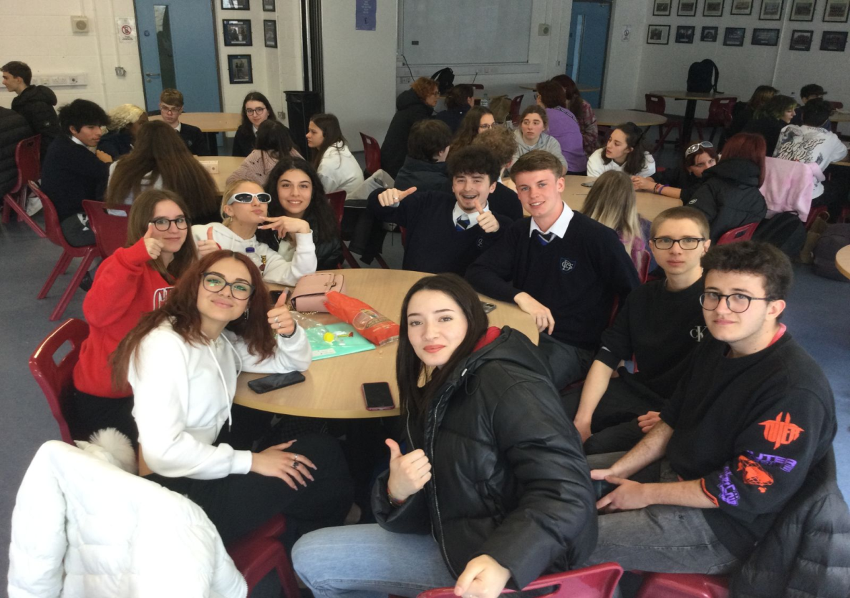
A memorable day at
The Erasmus project was one of the best experiences that the school could organize and that I have experienced.
Dundalk Grammar School is a very beautiful school because the people were very helpful and they organized a lot of interesting activities!
Thanks to this experience, I improved my English and I met some new people.
(Valentina)

Slide 3
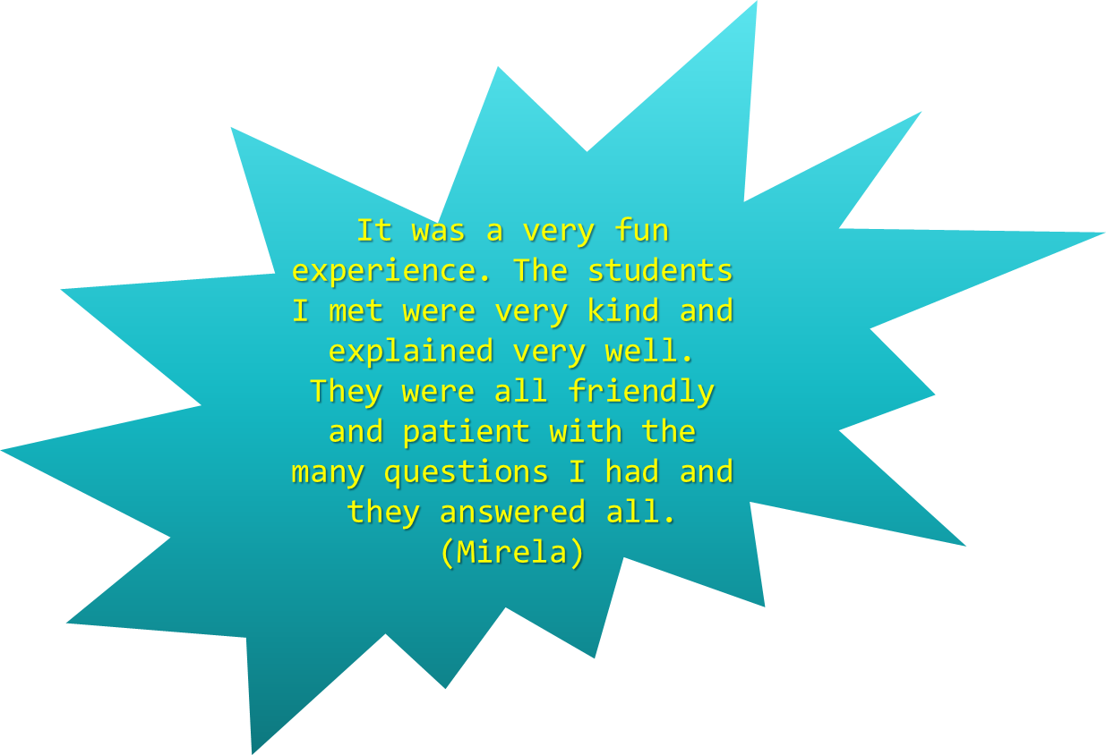
Thank you so much for your kind hospitality.
We will never forget this wonderful experience!
It was a great opportunity to improve our English, learn about a different culture and make new
friends.
(Vincenzo and Gabriele)

Slide 4
Hi!
I’m an Erasmus student, and I wanted to thank you for this wonderful opportunity that you have given us.
It was wonderful to have a cultural exchange with other people of our age, older, and younger.
I also wanted to congratulate you on your school. It is truly beautiful and spacious where every student can be educated in the best possible way,
….wonderful things will come out of that school…
If Icould I would go to your school right away to do my school years, really well done, you were really
welcoming and kind, thank you!
(Matilde)

Slide 5
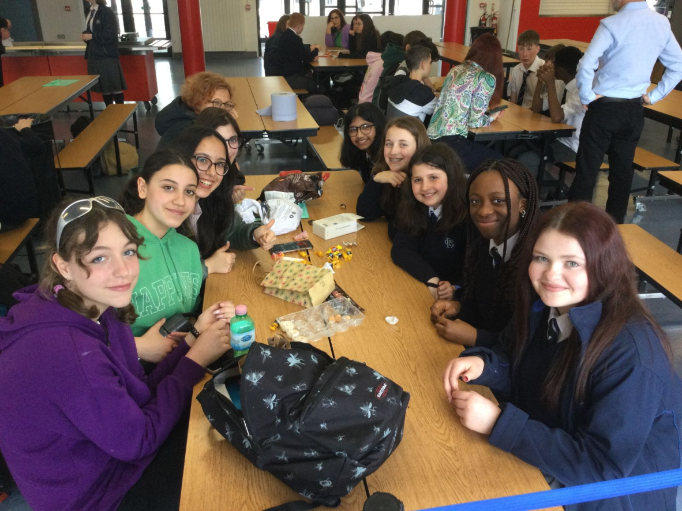
The experience at the grammar school was very nice and very useful for understanding the Irish school system, which is very different from ours. Plus talking to kids around our age was a lot of fun.
The school impressed us with its size and the various activities that can be done.
We’d love to host the kids we’ve met here in Italy at our school!!
Bea, Giorgia, Elena, Gloria and Giulia

Slide 6
The Erasmus experience is something that I recommend everyone to do at least once in their life.
I am very happy that I went to Ireland because it is a wonderful country. I enjoyed the experience
with Dundalk Grammar School a lot. The girls I was with including Cassidy, Eábha, Noami and Neyva
were super nice.
Truly a memorable experience!
(Giulia)

Slide 7
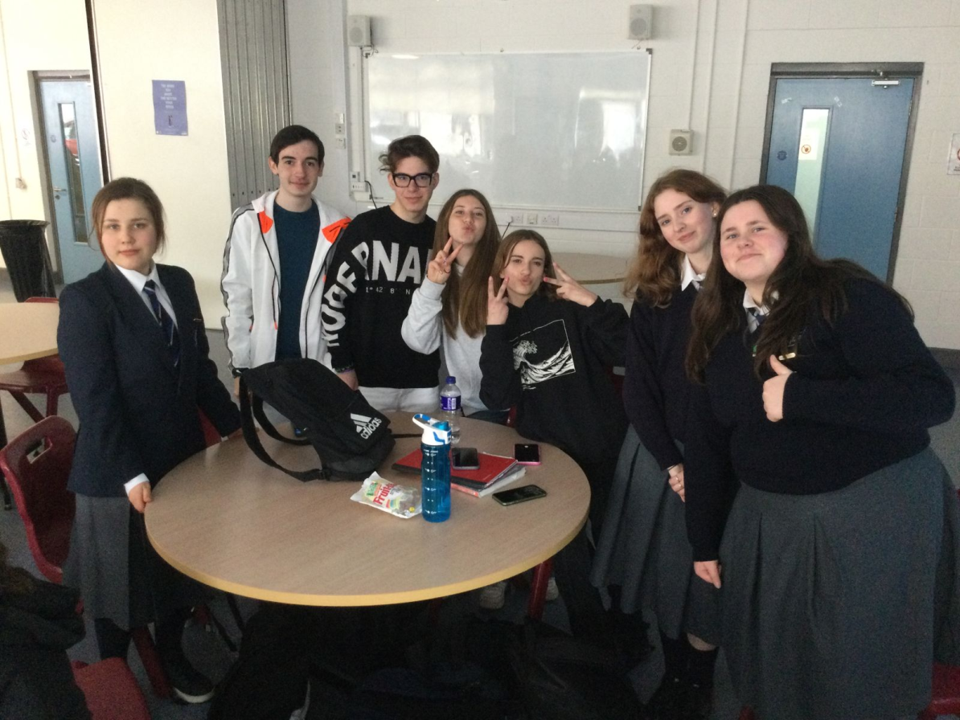
HI! We are writing to thank you very much for the excellent and interesting experience.
We really felt at ease and we were very intrigued
both by your stories and by the Irish school system which is very, let us say, very different from ours and we think that your school system would be very appreciated here in Italy.
It was very interesting to visit your campus and be able to see your classes that are known to have been lived, while here in Italy they are very sad and monotonous.
Also, we really enjoyed talking to you, in fact, the experience helped us to be more confident in ourselves and for this we want to thank you.
From Italy we send you
a big greeting!
(Cristian, Luca, Viviana)

Slide 8
The grammar school experience was wonderful.
I had a lot of fun, it was a very interesting visit also
to understand the points of view of the students of that school, the differences between the Italian
and Irish schools.
The guys who gave us the tour of the school were very kind and very nice.
It was
a fantastic experience!
(Aurora)
The experience at the grammar school was very interesting.
The school was very beautiful and I
was interested in the different systems that they have. the students were really nice and friendly
(Aurora Popescu)

Slide 9
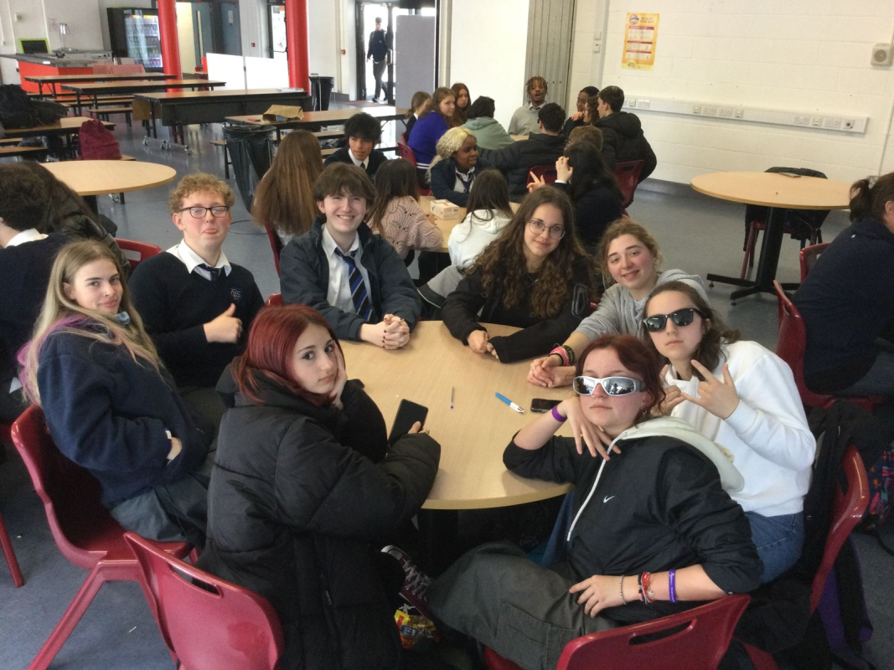
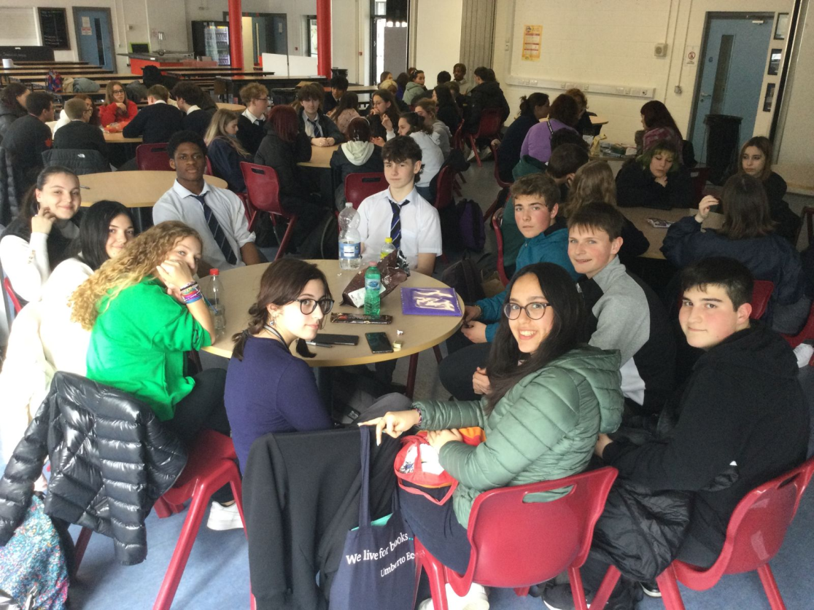
The experience at the grammar school was wonderful, seeing how Irish kids grow up differently
from us is interesting and it was nice to hear their stories. It was nice how they welcomed us and I
hope they had a good time with us too!
(Lu)
Aurora and I loved the meeting at the grammar school. The girls were able to respond to all our
curiosities by making us take a beautiful tour of their school. We really appreciated the diversity
between us. It was a fantastic experience! (Rachele and
Aurora)

Slide 10
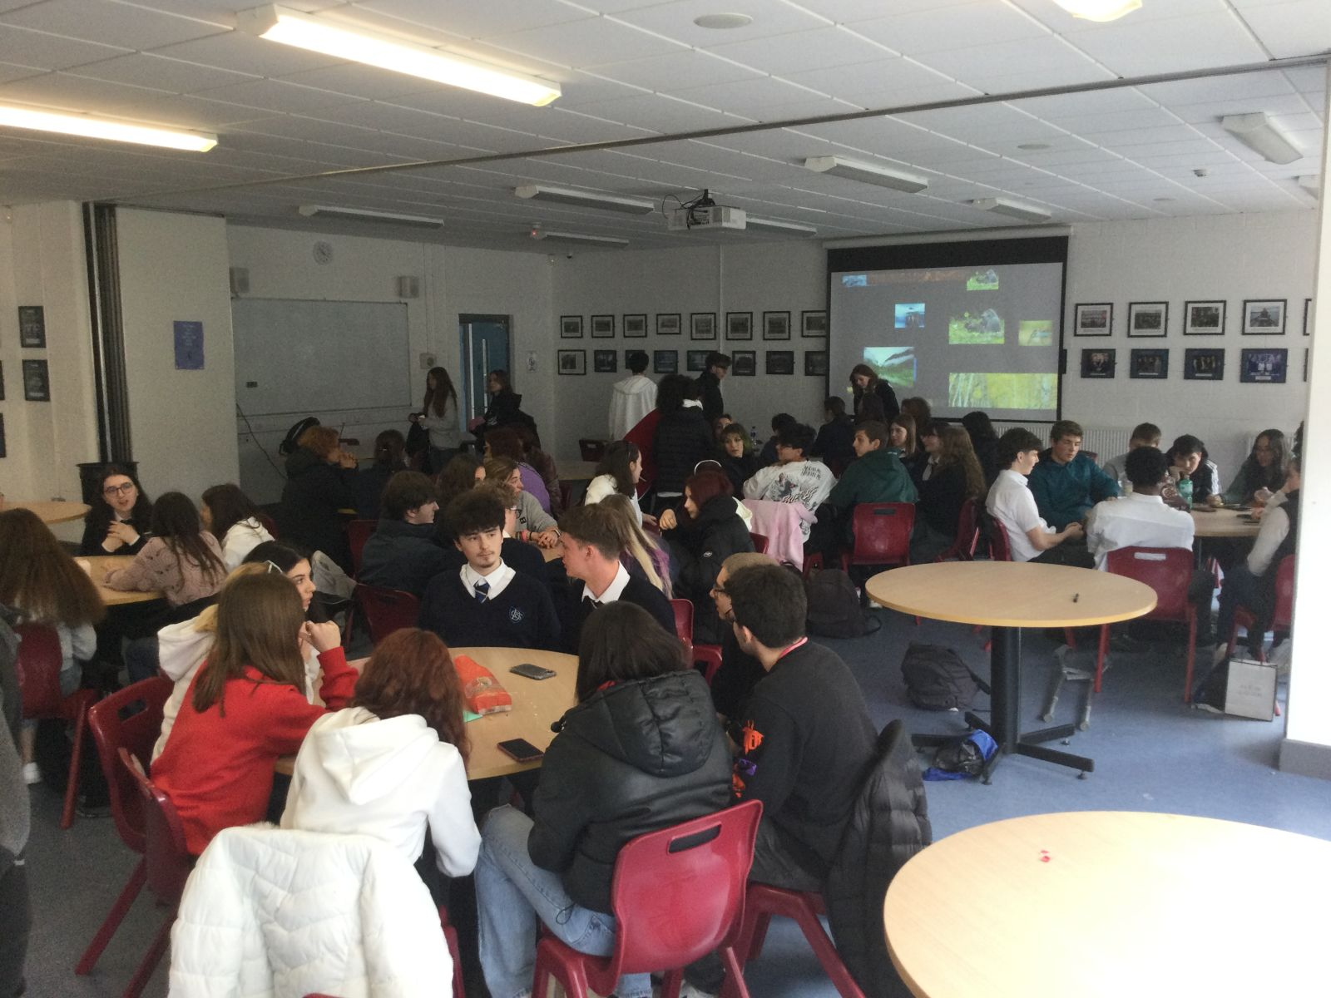
The experience at the grammar school was amazing, we learned what it is like to go to an Irish school and we can say that we fell in love with their school system and also with the school itself which was beautiful, big and had a lot of decorations.
It would be amazing to spend another week there to learn what it is like to be a teenager in Ireland.
Also the students were very kind and funny and they taught us how the school works.
We would love to host them in Italy and to teach them what is like at the school here.
(Aurora and Sofia)

Slide 11
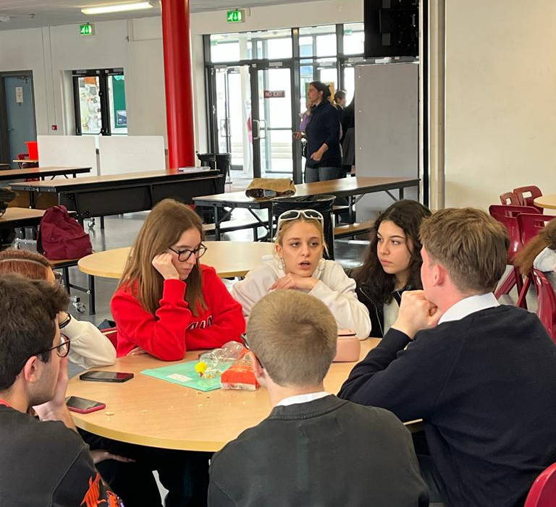
It was a fantastic experience and one I will never forget. I learned things about Irish culture that I didn’t know before and met new people.
At the Grammar school we were welcomed by the guys and after doing some activities we got to know each other a bit.
I loved everything!!!
(Giorgia)

Slide 12
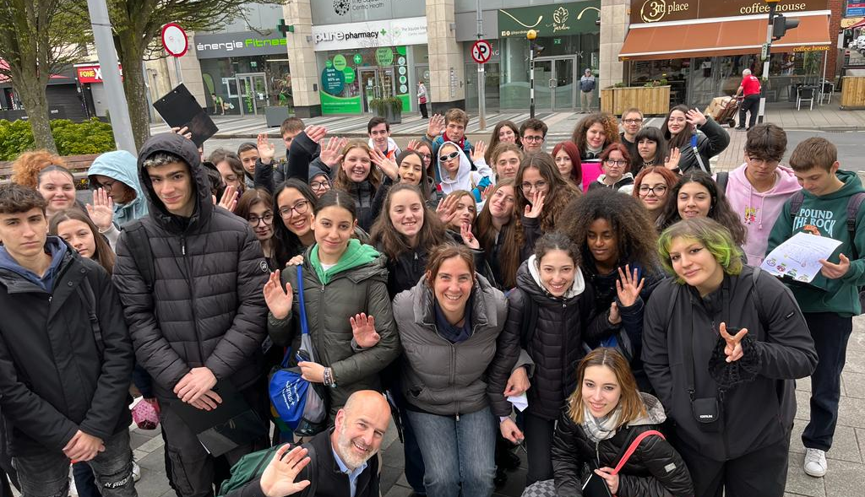
My experience with the Erasmus project was one of the best in my life. I learned a lot about Irish
culture and the customs of the Irish people.
My experience with the grammar school has been very useful in learning about the education system of Ireland and meeting very interesting people.
I really liked Dublin and Belfast and of course also Dundalk, characteristic cities that I will remember for the rest of my life.
Thank you for this wonderful experience which has been useful for me to improve my English and meet new people at the school.
(Matteo)

