Slide 1
5th Year Subject Choice
DGS Guidance & Counselling Service
10th March 2021

Slide 2
Decisions
My Future
Courses
Subjects
Levels
Career

Slide 3
An Overview
Advice on Choosing Subjects for Leaving Certificate
Subject Choice at DGS – The Process
The National Framework of Qualifications
College Entry Requirements
Recent Trends in College Application
Resources

Slide 4
When Considering Your Subjects…
Interest
Ability & Aptitude
Career
Subjects which complement each other
Course work & projects

Slide 5
Seek Advice…
Students currently in 5th & 6th Year
Subject Teachers
Parents & Family
Work Experience
College Virtual Open Events/Q&A
Guidance Counsellor

Slide 6
Subject Choice at DGS
Students can take up to 8 Timetabled Subjects
Core Subjects Optional Subjects
Maths Choose from 18 Subjects
English
Irish
Modern Language
4 + 4

Slide 7
Optional Subject list
Physics Chemistry Biology Agricultural Science
Accounting Business Economics LCVP
Geography History Music Politics & Society
Const. Studies DCG Art Home Economics
PE (New LC) *Applied Maths
* Please note Applied Maths takes place two mornings a week (7.50 – 8.50a.m.)
There is also an additional charge for doing Applied Maths.

Slide 8
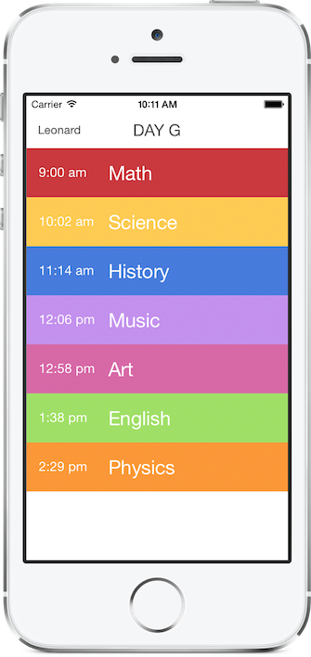
Subject Choice – The Process
Step1 – by 15th March
TY students complete & return their Subject Preference Form (indicating 6 option subjects)
The information provided by each student is entered into our timetabling software programme
This generates the Subject Groups/Backings for 5th Year 2021

Slide 9
Subject Choice – The Process
Step 2 – Students & Parents receive the Official Subject Choice Form (26th March)
Students select one subject from each option group (1-4) & also indicate if they wish to take Applied Maths.
The Subject Choice Form must be returned from Tuesday 13th April

Slide 10
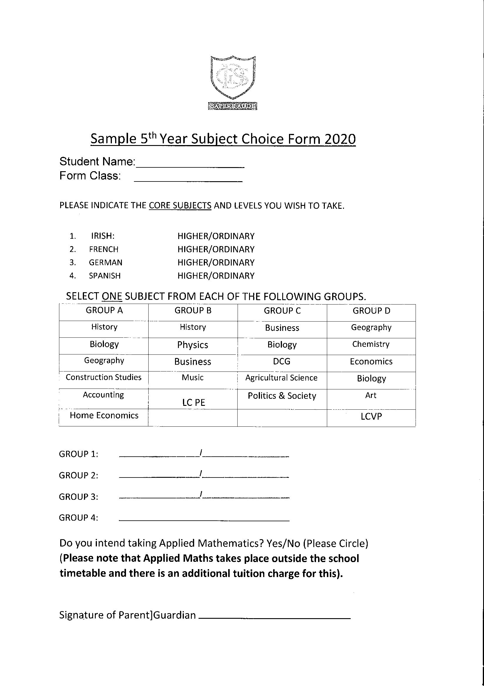
Sample Subject Choice Form

Slide 11
Complementary Subjects
Home Economics- Biology-Ag Science-Business-Politics & Society- Physical Education
Biology, Ag Science, Geography
Business, LCVP, Politics & Society, Home Economics, Economics
Politics & Society: Business, Economics, History, Geography, LCVP, Home Economics
Physics & Applied Maths

Slide 12
Subjects with Coursework Elements
Assessments take place prior to sitting the Written Exam in June 2023
Art (62.5%) Geography (20%)
LCVP (60%) History (20%)
Music (50%) Politics & Society (20%)
Construction (50%) Economics (20%)
Design & Communication Graphics (40%) Home Economics (20%)
Ag Science (25%)
PE (50%)

Slide 13
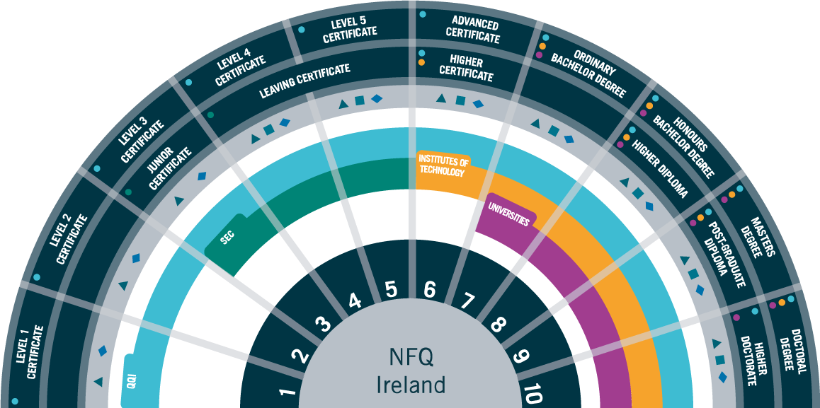
The National Framework of Qualifications

Slide 14
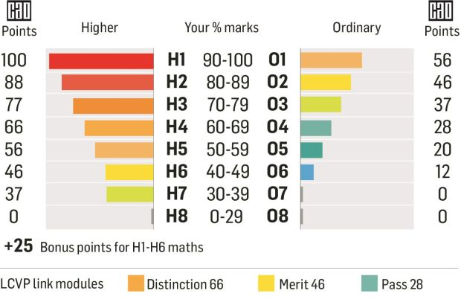
College Entry Requirements
Leaving Cert Grading & Points System (2017)

Slide 15
College Entry Requirements
1. Meet the Minimum Entry Requirements for the Course
Level 8 (2 X H5 + 4 x O6/H7)
2. Meet the Subject Specific Course Requirements
Veterinary = Chemistry @ H5 Most Uni Engineering Programmes = Higher Maths @ H4
3. Achieve the required points for the course
(Calculated on your 6 best grades in Leaving Cert 2023)

Slide 16
Recent Trends in College Application
DGS Class of 2020
23% - Arts/Humanities
21% - Science (including Health Sciences)
19% - Business
17% - Construction/Built Environment
12% - Computing/IT
6% - Art & Design
2% - Apprenticeships

Slide 17
College Application

Slide 18
Resources
https://www.qualifax.ie/ (database of all college courses in Ireland)
https://careersportal.ie/ (college information/search tools for scholarships/occupation finder)
https://www.cao.ie/ (Irish College Application System)
https://www.techireland.org/companies/unibrowse (course search facility for Irish Colleges)
https://www.examinations.ie/ (past exam papers can be viewed across all LC subjects)
https://www.studyclix.ie/ (excellent study resource for students)
https://www.625points.com/ (study tips from students who achieved max points)
https://accesscollege.ie/ (information on the DARE & HEAR College Schemes)

Slide 19
Resources
https://www.ucas.com/ (course search facility for students considering applying to the U.K.)
https://www.eunicas.ie/ (database & application system for those applying to European Uni’s)
https://www.collegeboard.org/ (for students interested in applying to the USA)
https://apprenticeship.ie/ (information on Apprenticeships)
https://www.military.ie/en/#1 (careers in the Defence Forces)
https://www.garda.ie/en/ (careers in An Garda Siochana)
https://www.smartfutures.ie/ (career information in STEM subjects)

Slide 20
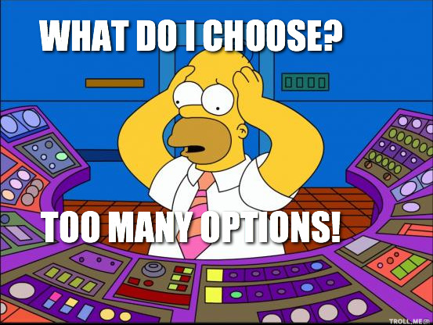

Slide 22
Thank you
Email A.Norton98@dgs.ie
https://careersportal.ie/careerguidance/office.php?school_id=528
©DGS Guidance & Counselling Service
2020/21

